Slide 1
LLVM INLINE PASS
Lingxuan(Linda) Chen
Po Yu Huang

Slide 2
Introduction
This is project is to create an inlining pass in the compiler LLVM to speed up compiling.
This is project is done by 2 people group.

Slide 3
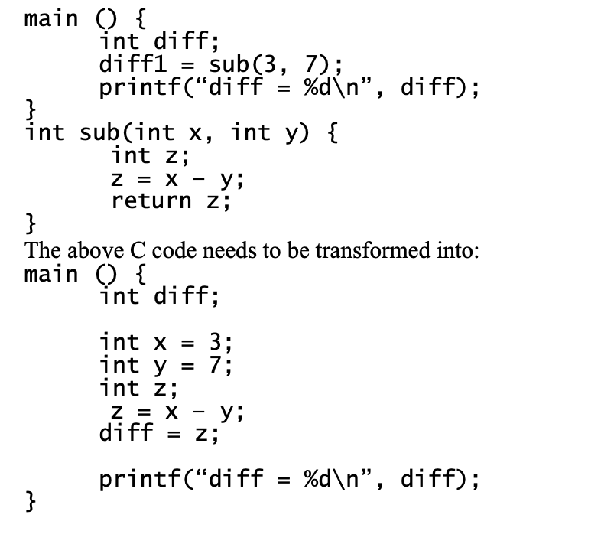
Design Flow
Requirements:
Only inline where there is less than 10 instructions.
Only inline constants.
Transforms the following C code.
Modify the IR file(.ll).
In this project, each function has only one call-site.

Slide 4
Algorithm
1. Loop over all the instructions and get the called functions.
inst_begin(), inst_end(), getCalledFunction()
2. Loop through all the arguments in the called functions.
arg_begin(), arg_end()
3. Check if the arguments are constants
4. Create a ConstantInt which contains the current value.
5. Replace all the uses of formal argument with the ConstantInt created above.
replaceAllUsesWith(Value *V)

Slide 5
6. Copy and clone the modified instructions to the call-site.
Loop through all the instruction in the called function
Clone each of them into a new instruction and insert them to the call-site
7. Remove the called instructions.
I -> eraseFromParent()
8. Constant propagate the constant local variables.
opt -constprop <input bytecode> -o <output bytecode>

Slide 6
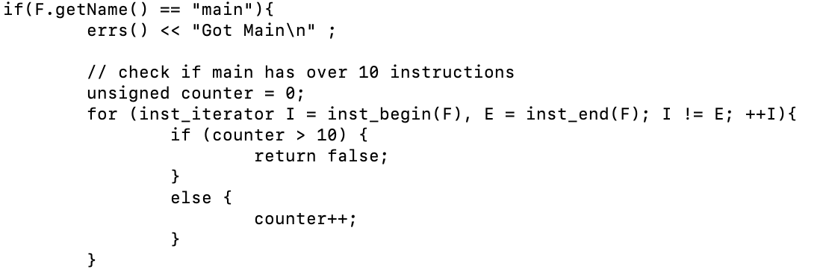
Checks if there are more than 10 instructions

Slide 7
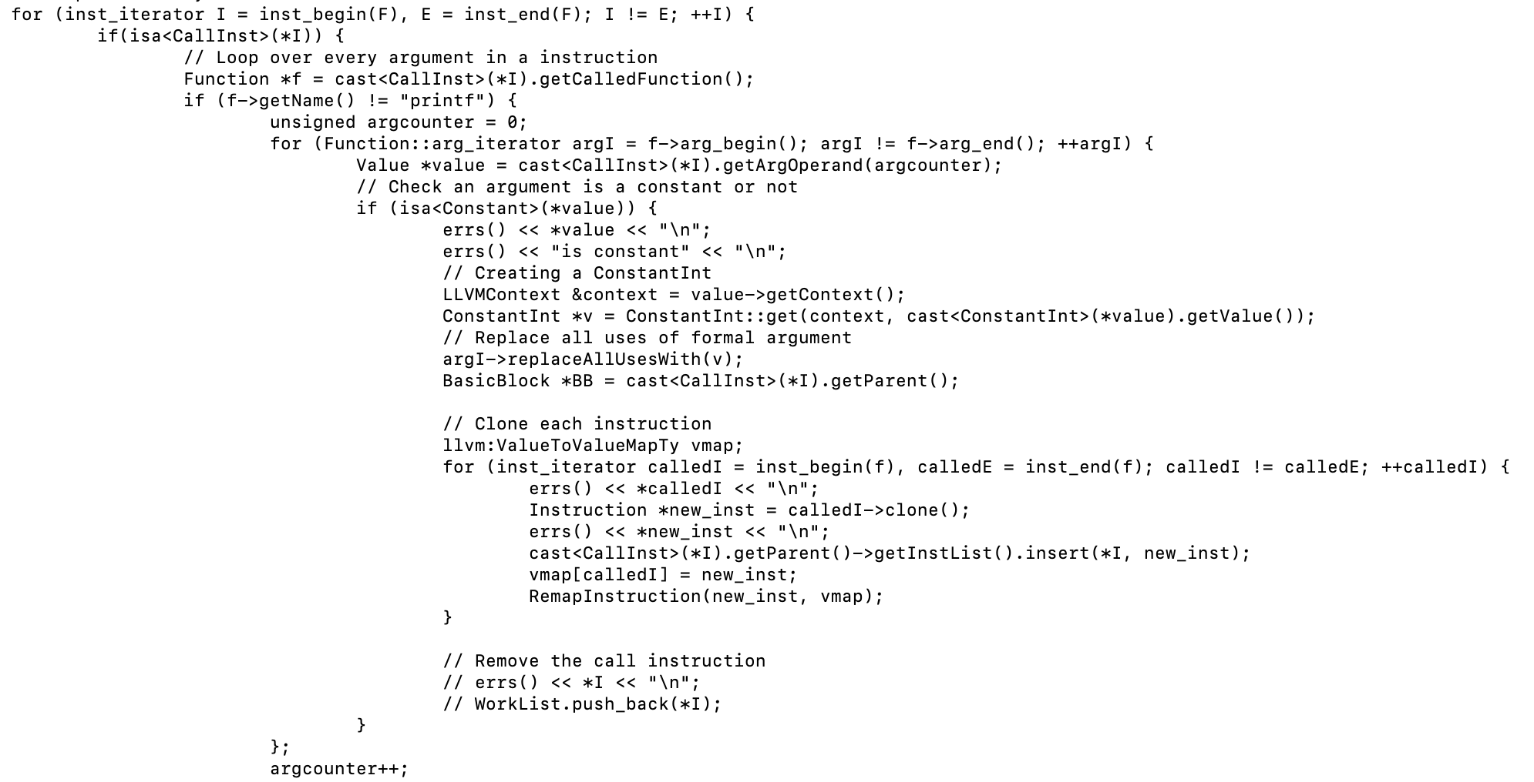
Loop through all the instructions
Loop through all the arguments
Checks if the arguments are constants
Creating a new ConstantInt
Replace the formal values
Clone the instructions in the called functions

Slide 8
Bugs
Step 4
The string in printf() is also a constant, but it would cause the creation of the ConstantInt to fail.
Temporary solution: Ignore all printf() functions
Step 6.
“instruction does not dominate all uses”
<badref> during cloning instructions.
ValueToValueMap construction problems, mainly because of different versions of LLVM
Step 7
Deleting call instruction would create a null pointer which would cause the loop to fail.
Solution: Save the Instruction in a list and delete the instructions after looping all the instructions.

Slide 9
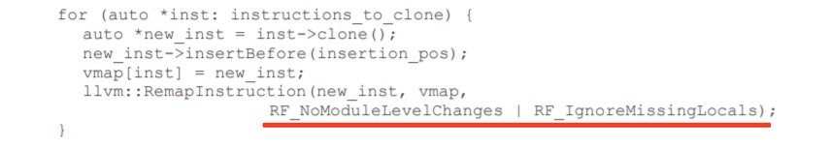
The two variable do not exists in LLVM version3.4

Slide 10
Other Issues
Version issues between 3.4 and 13, LLVM on the glue machine is version 3.4 but the latest version is 13
Documentation out-of-date, difficulties on searching for version 3.4 documentation
Failed to install a local LLVM
Compiling on the local LLVM takes about 3-5 minutes
Project Description inconsistency.
Some confusions in the project description, some of the examples provided are not constants.

Slide 11
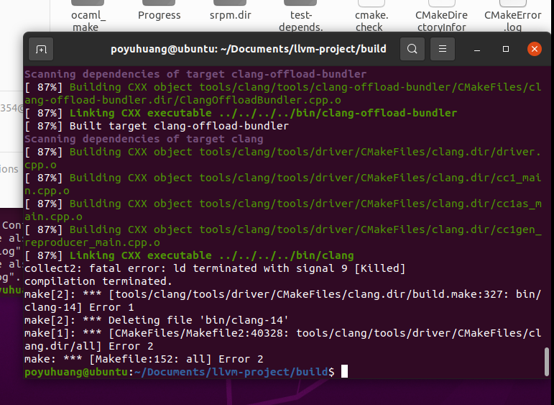
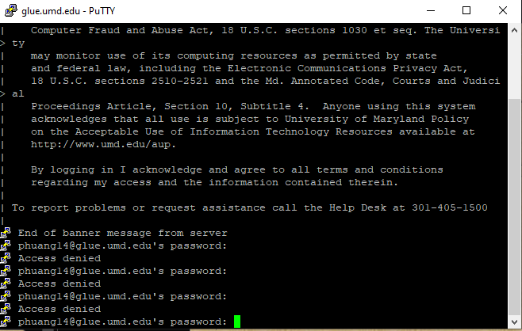
Other Issues
cargo run --release --verbose --jobs 1
RAM issues from 2GB to 8GB
Version issues between 3.4 and 13

Slide 12
Test/Verification
We used the tests provided in the glue machine and the project description to test.
Should not inline if there are more than 10 instruction
Should not inline if the value is not a constant.

Slide 13
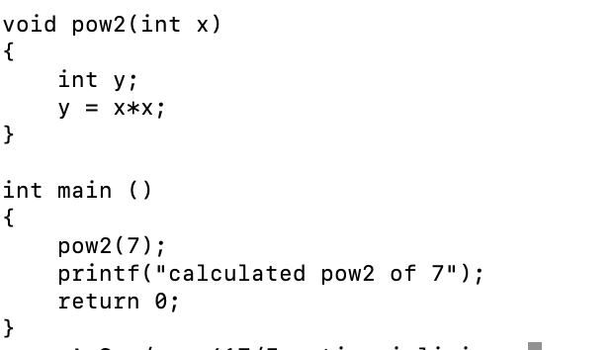
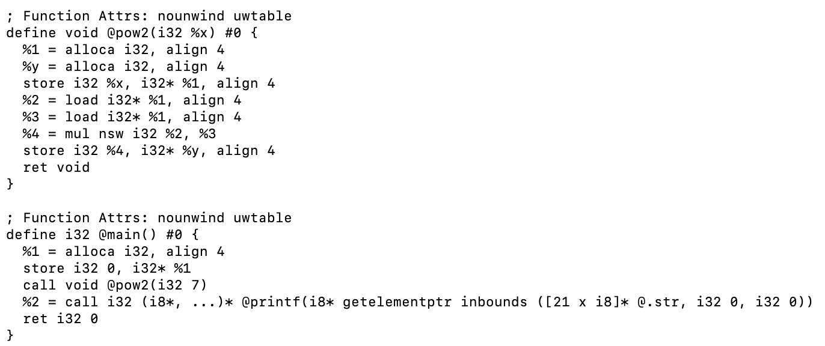
Test/Verification

Slide 14
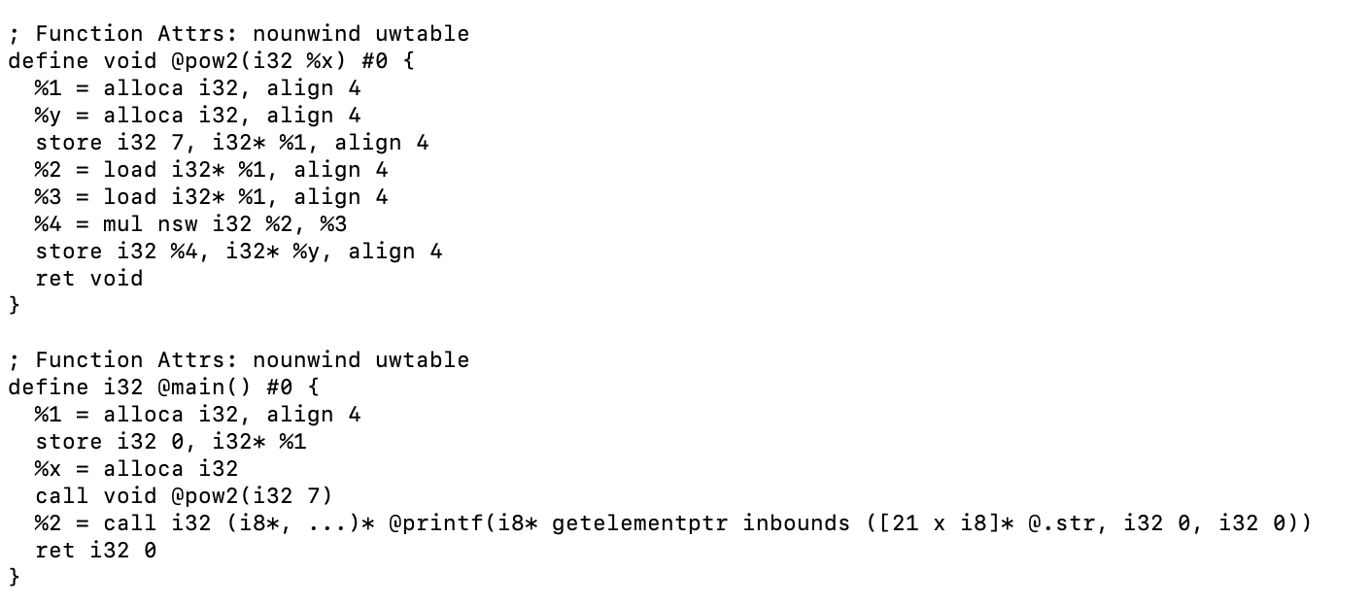
Test/Verification

